Slide 1
Trajectory of Information Entropy During peptide folding. Case study: lk14
David Corbo
Mentor: Sid Rath, tatum hennig
dcorbo3@uw.edu
1/30/20
PI: M. Sarikaya

Slide 2
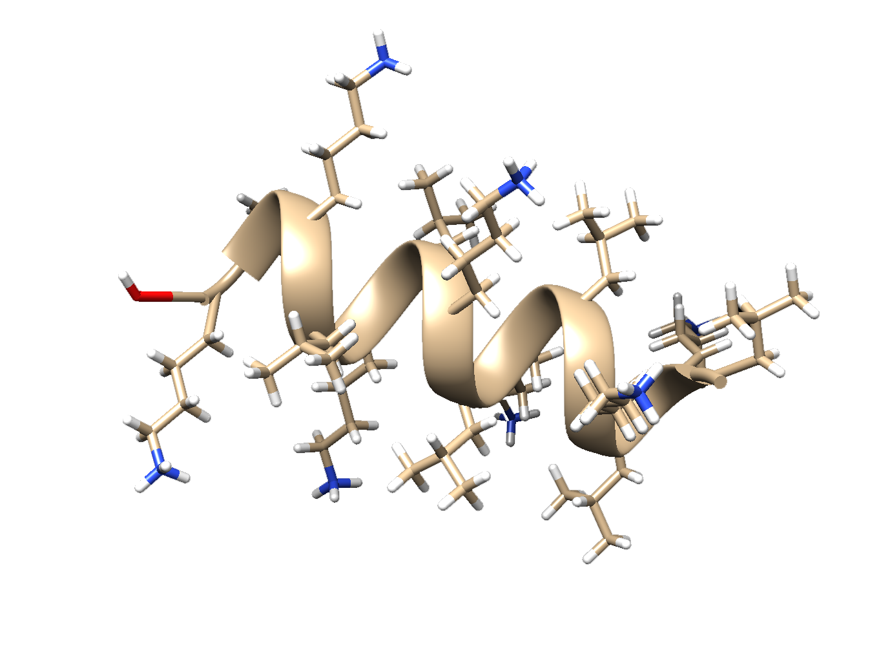
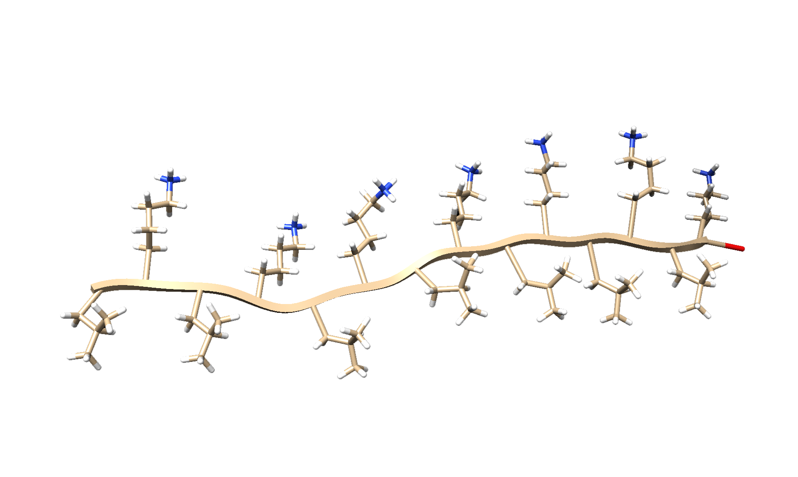
Goal
Prove that uncertainty in electron energy values increases upon formation of stable secondary structures

Slide 3
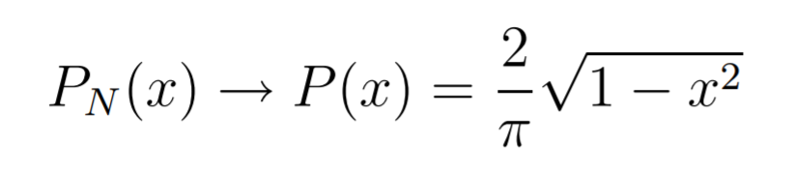
Literature
Joanna R. Long, Nathan Oyler, Gary P. Drobny, and Patrick S. Stayton, “Assembly of α-helical Peptide Coatings on Hydrophobic Surfaces,” Journal of the American Chemical Society 2002 124(22), 6297-6303 DOI: 10.1021/ja011624n
Bertrand Eynard, Taro Kimura, and Sylvain Ribault, “Random Matrices,” 2015 arXiv:1510.04430
Yi-Kai Liu, “Statistical Behavior of the Eigenvalues of Random Matrices,” Mathematics Junior Seminar Spring 2001, Princeton University
Semicircle Rule

Slide 4
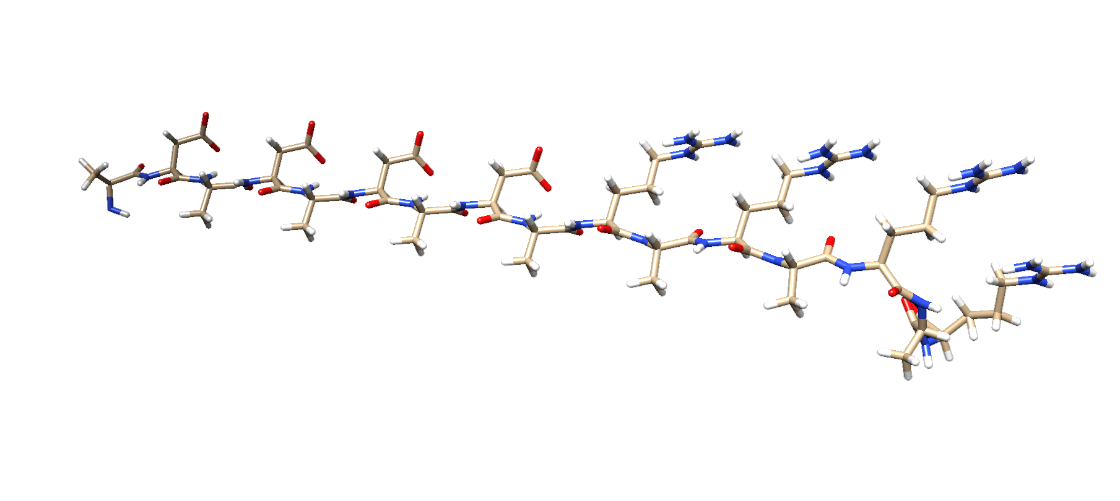

MD simulations
Got acquainted with Schrodinger
Ran simulation for evolution of LK14
Running simulations for evolution of DAR16-IV (second case study α to β transition)

Slide 5
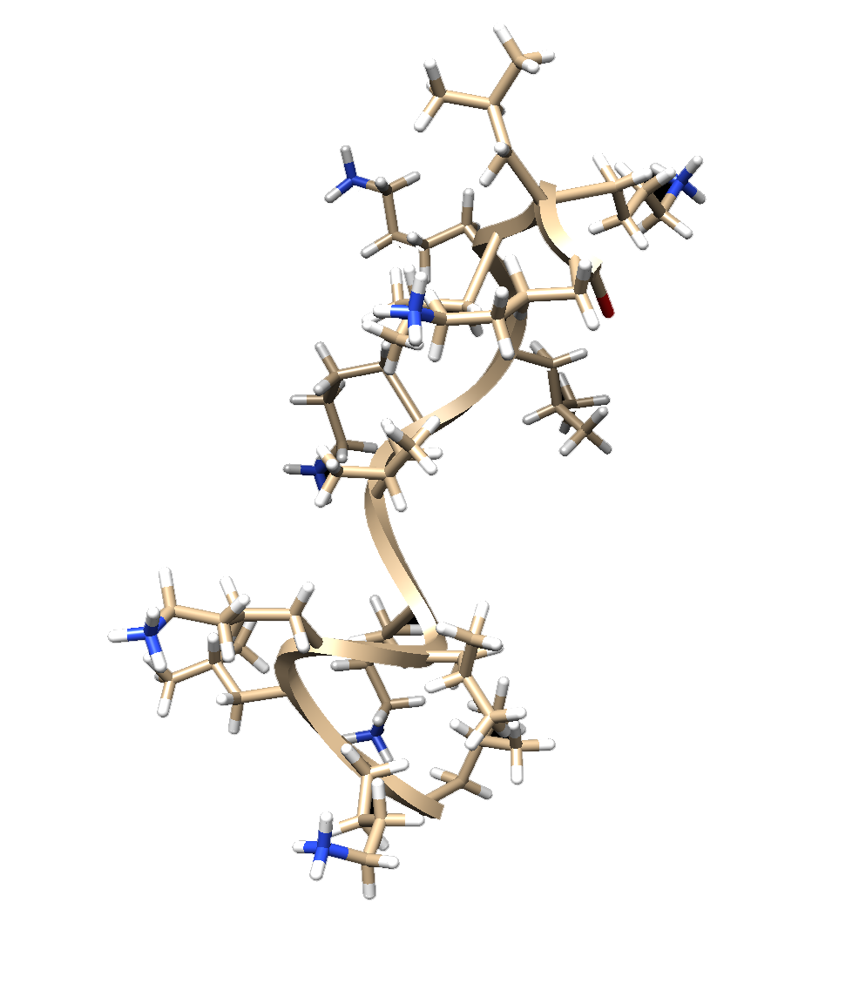
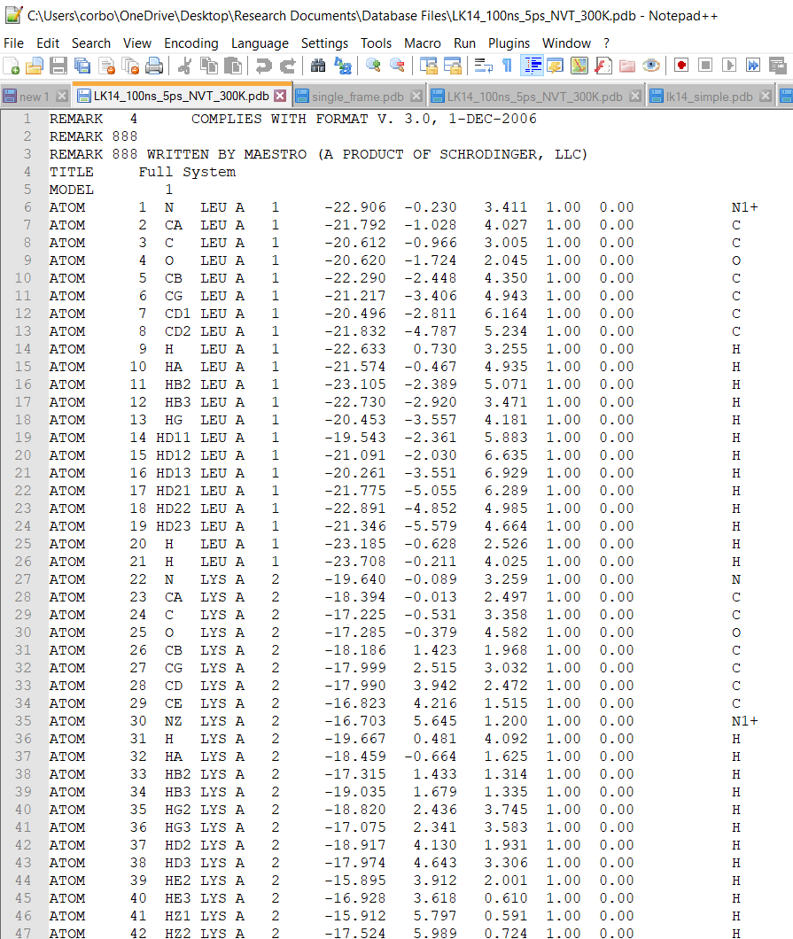
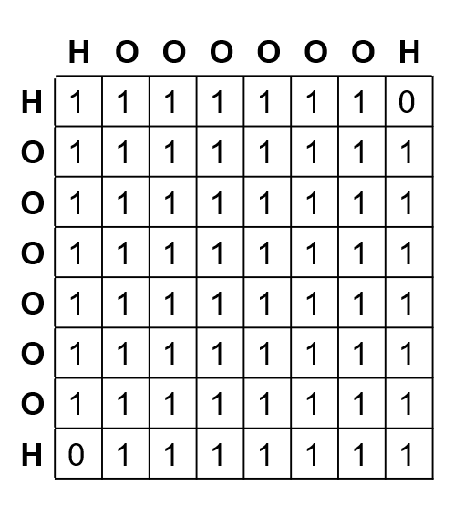
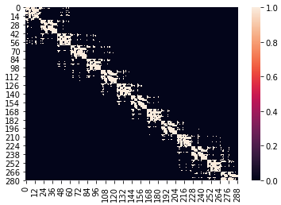
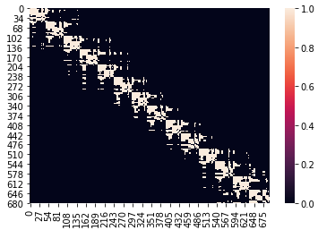
Analysis of data
 | H | O | H
H | 1 | 1 | 0
O | 1 | 1 | 1
H | 0 | 1 | 1
Extraction of PDB
Creation of Atom Adjacency Matrices
Creation of Valence Electron Adjacency Matrices
Analysis of Dynamics of Electron Adjacency Matrices

Slide 6
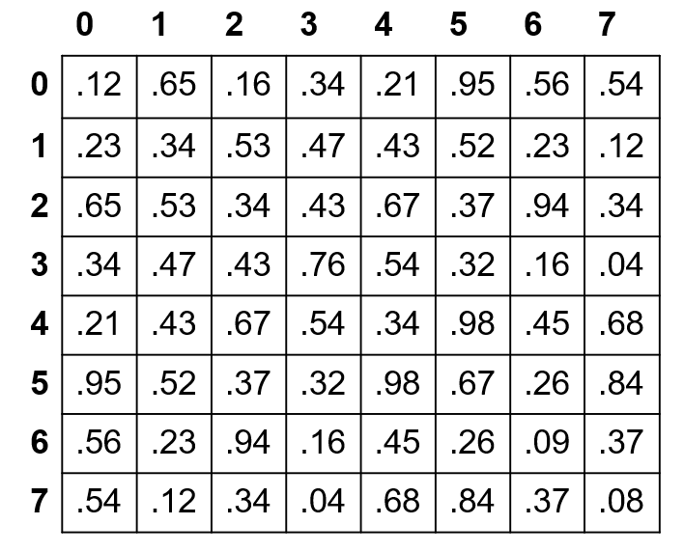
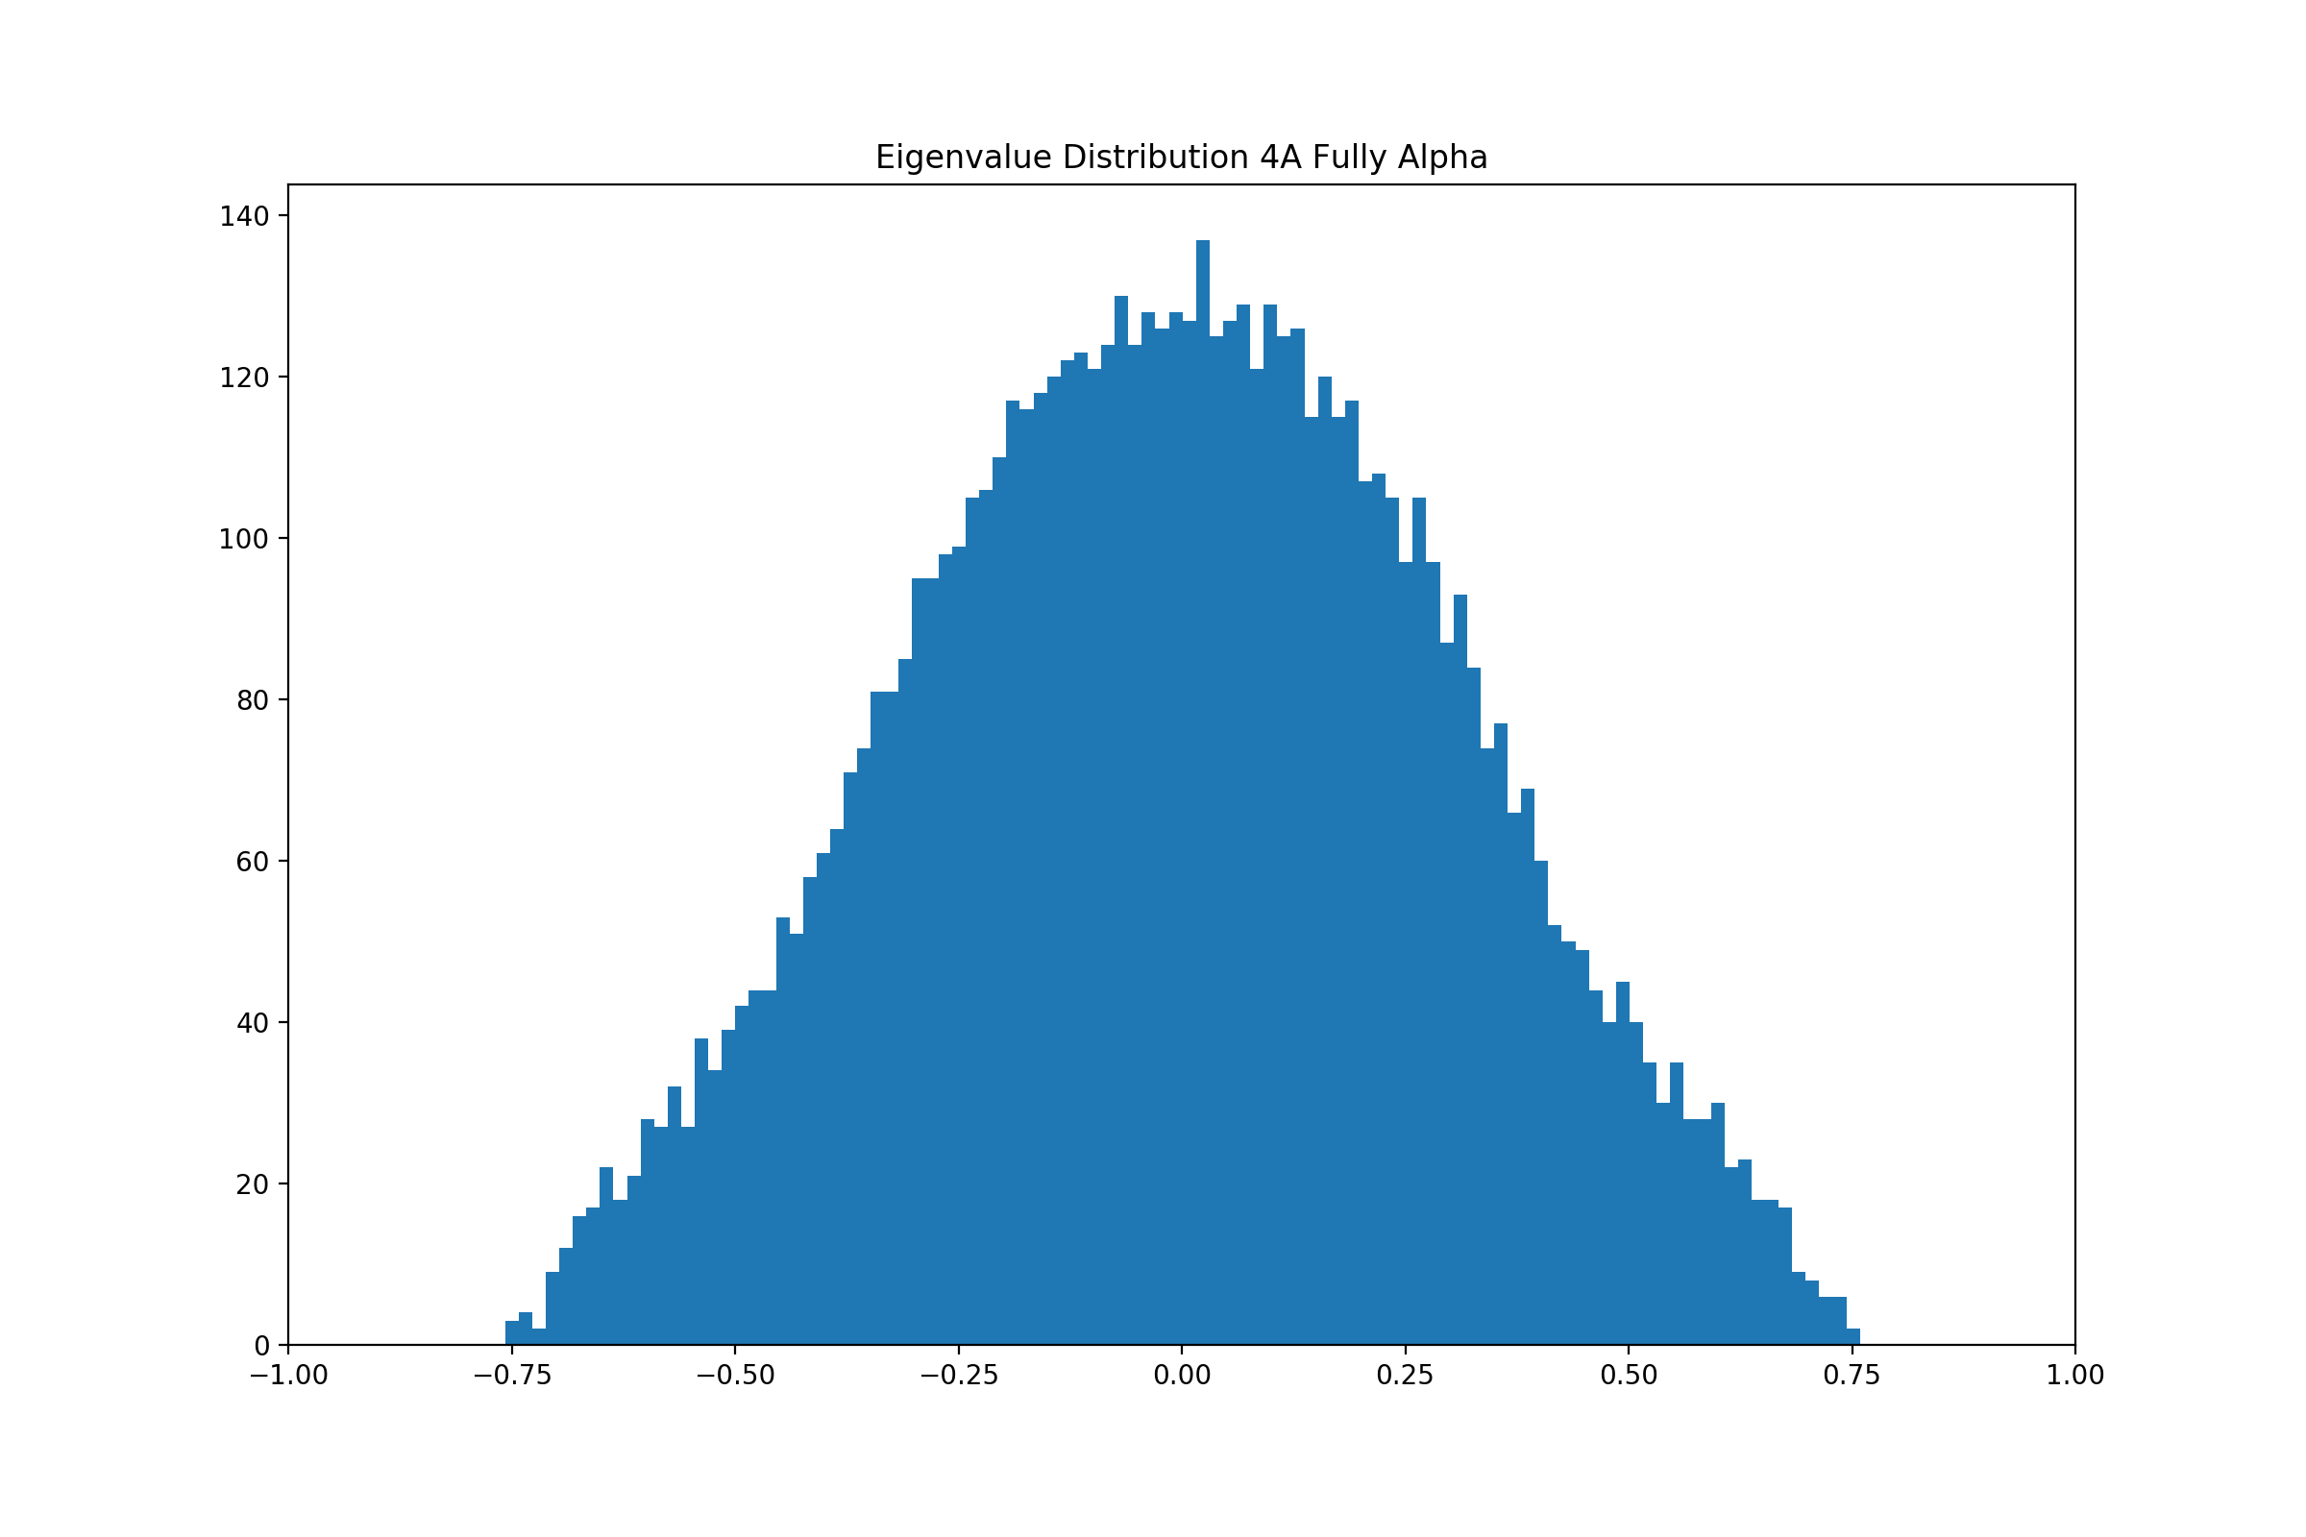

Analysis of data
Symmetric normal matrix imposed on adjacency matrix
Calculation of eigenvalues
Analysis of eigenvalues

Slide 7
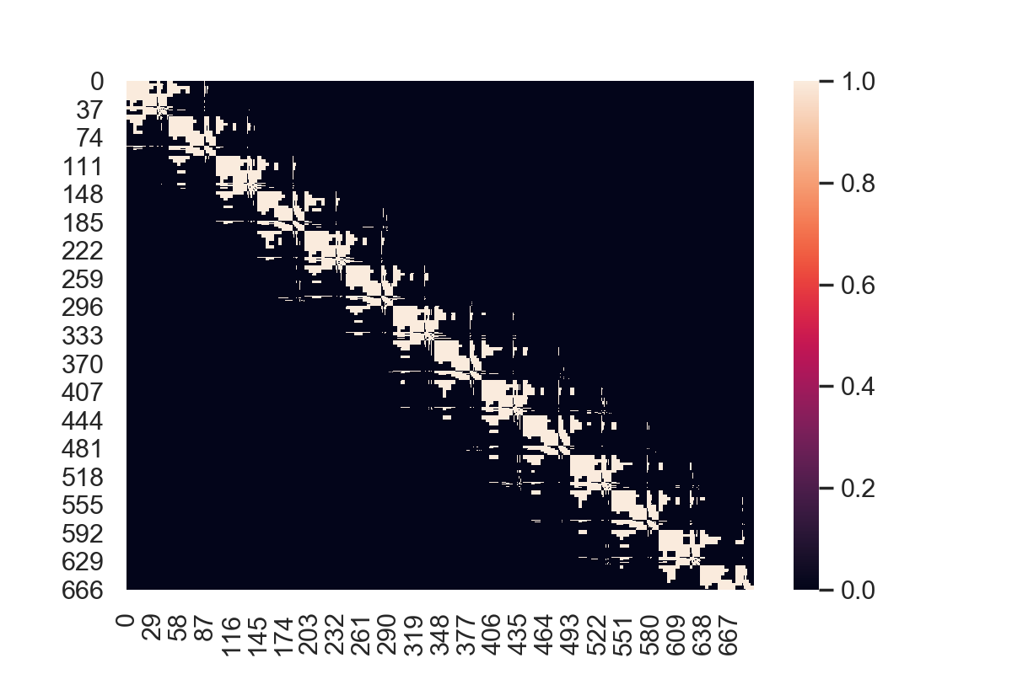
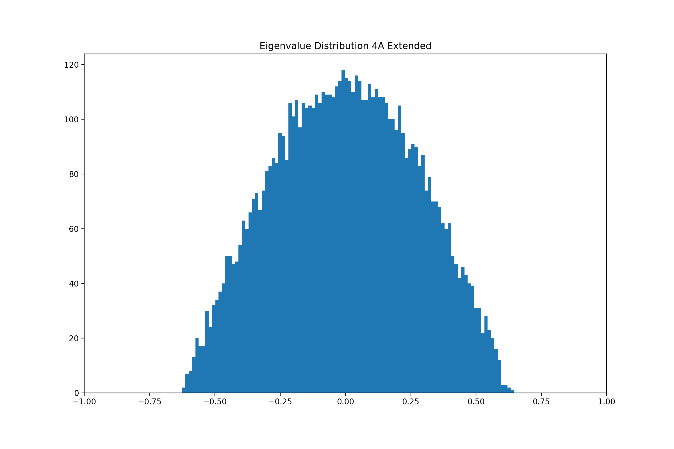
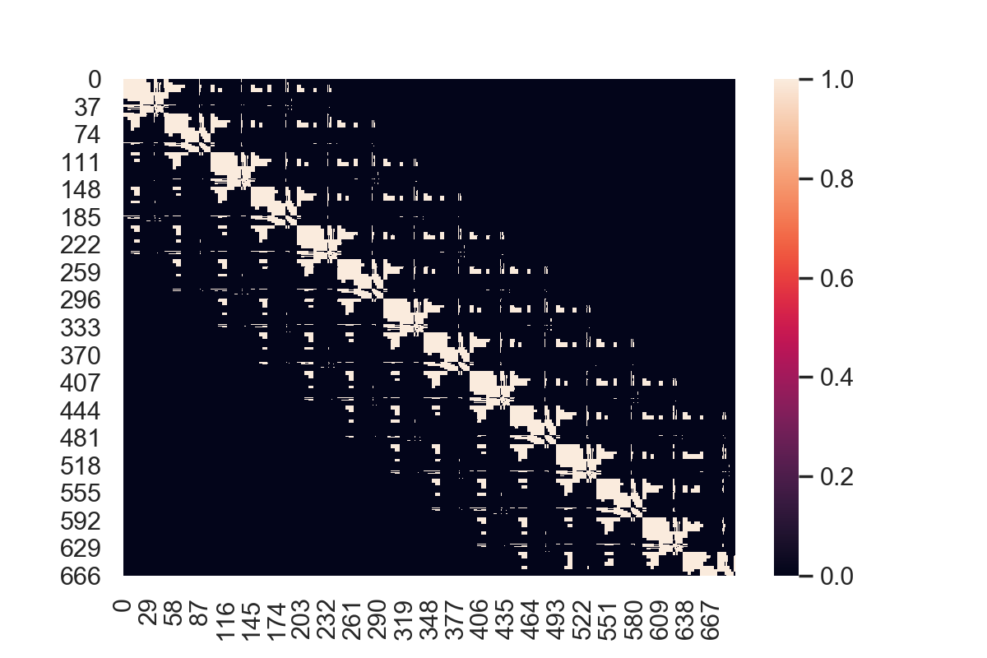
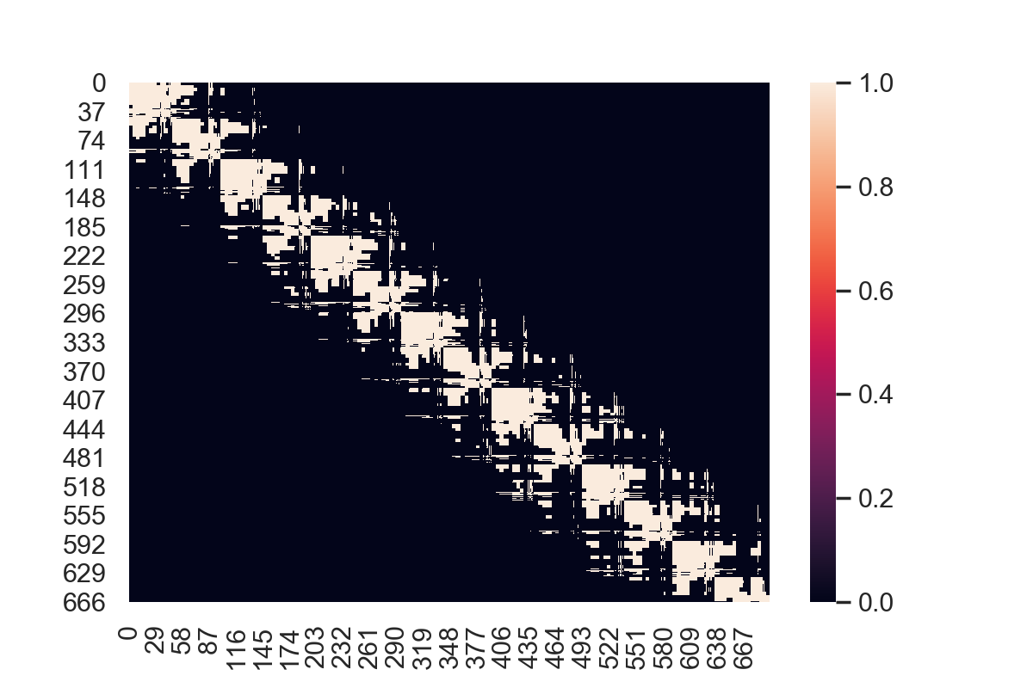
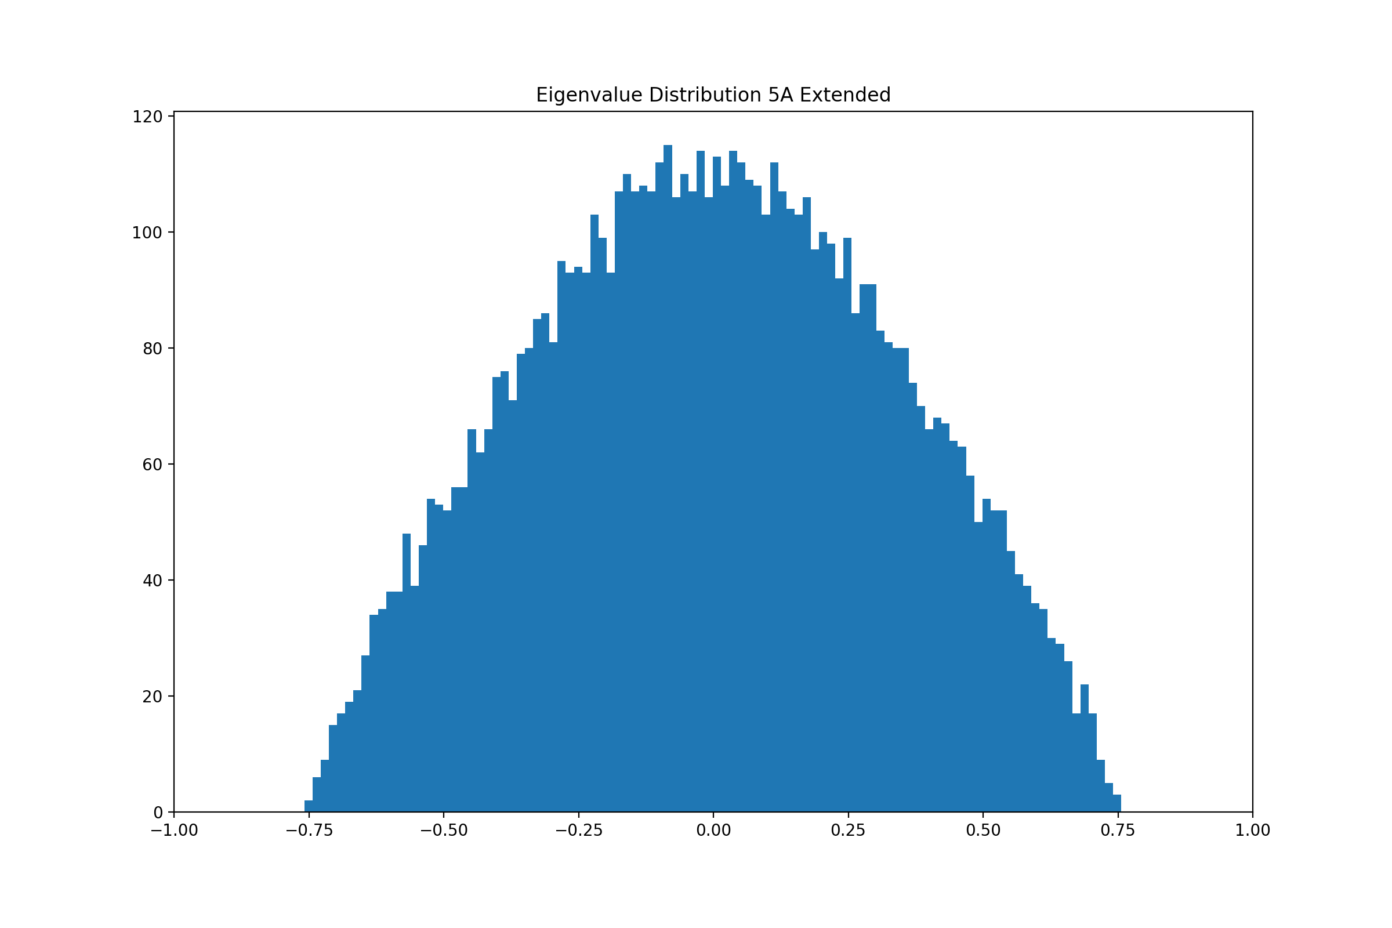
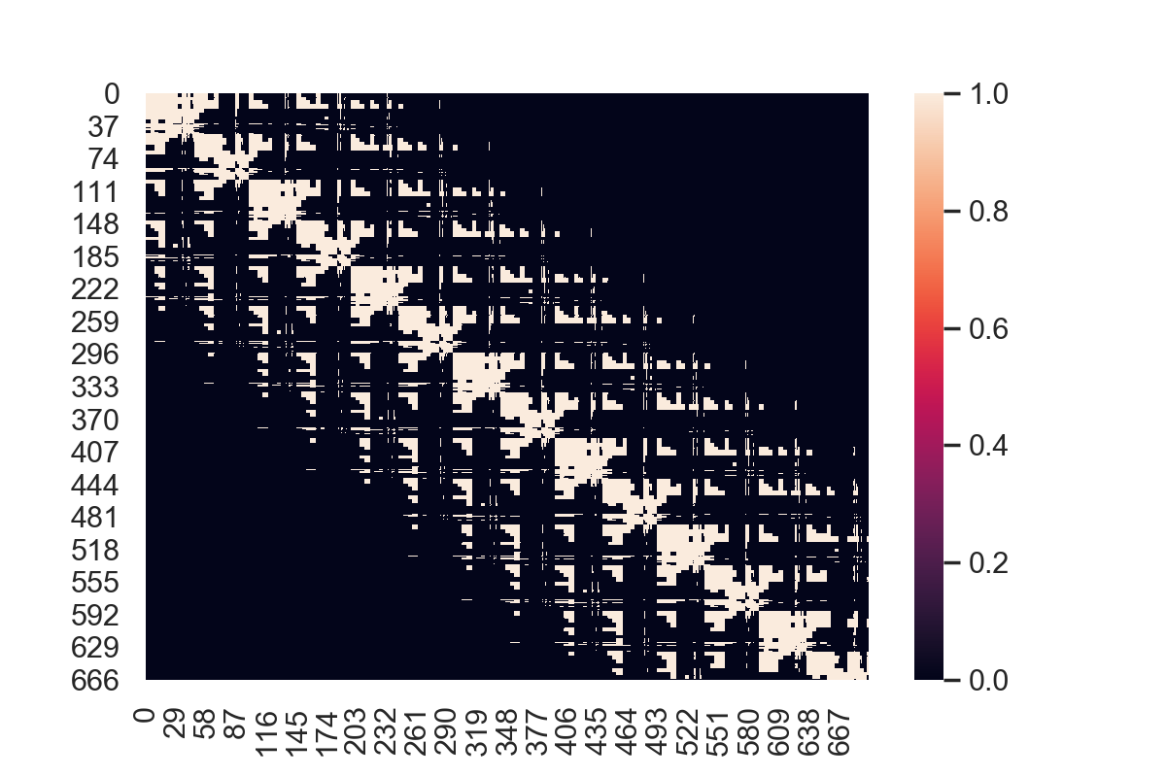
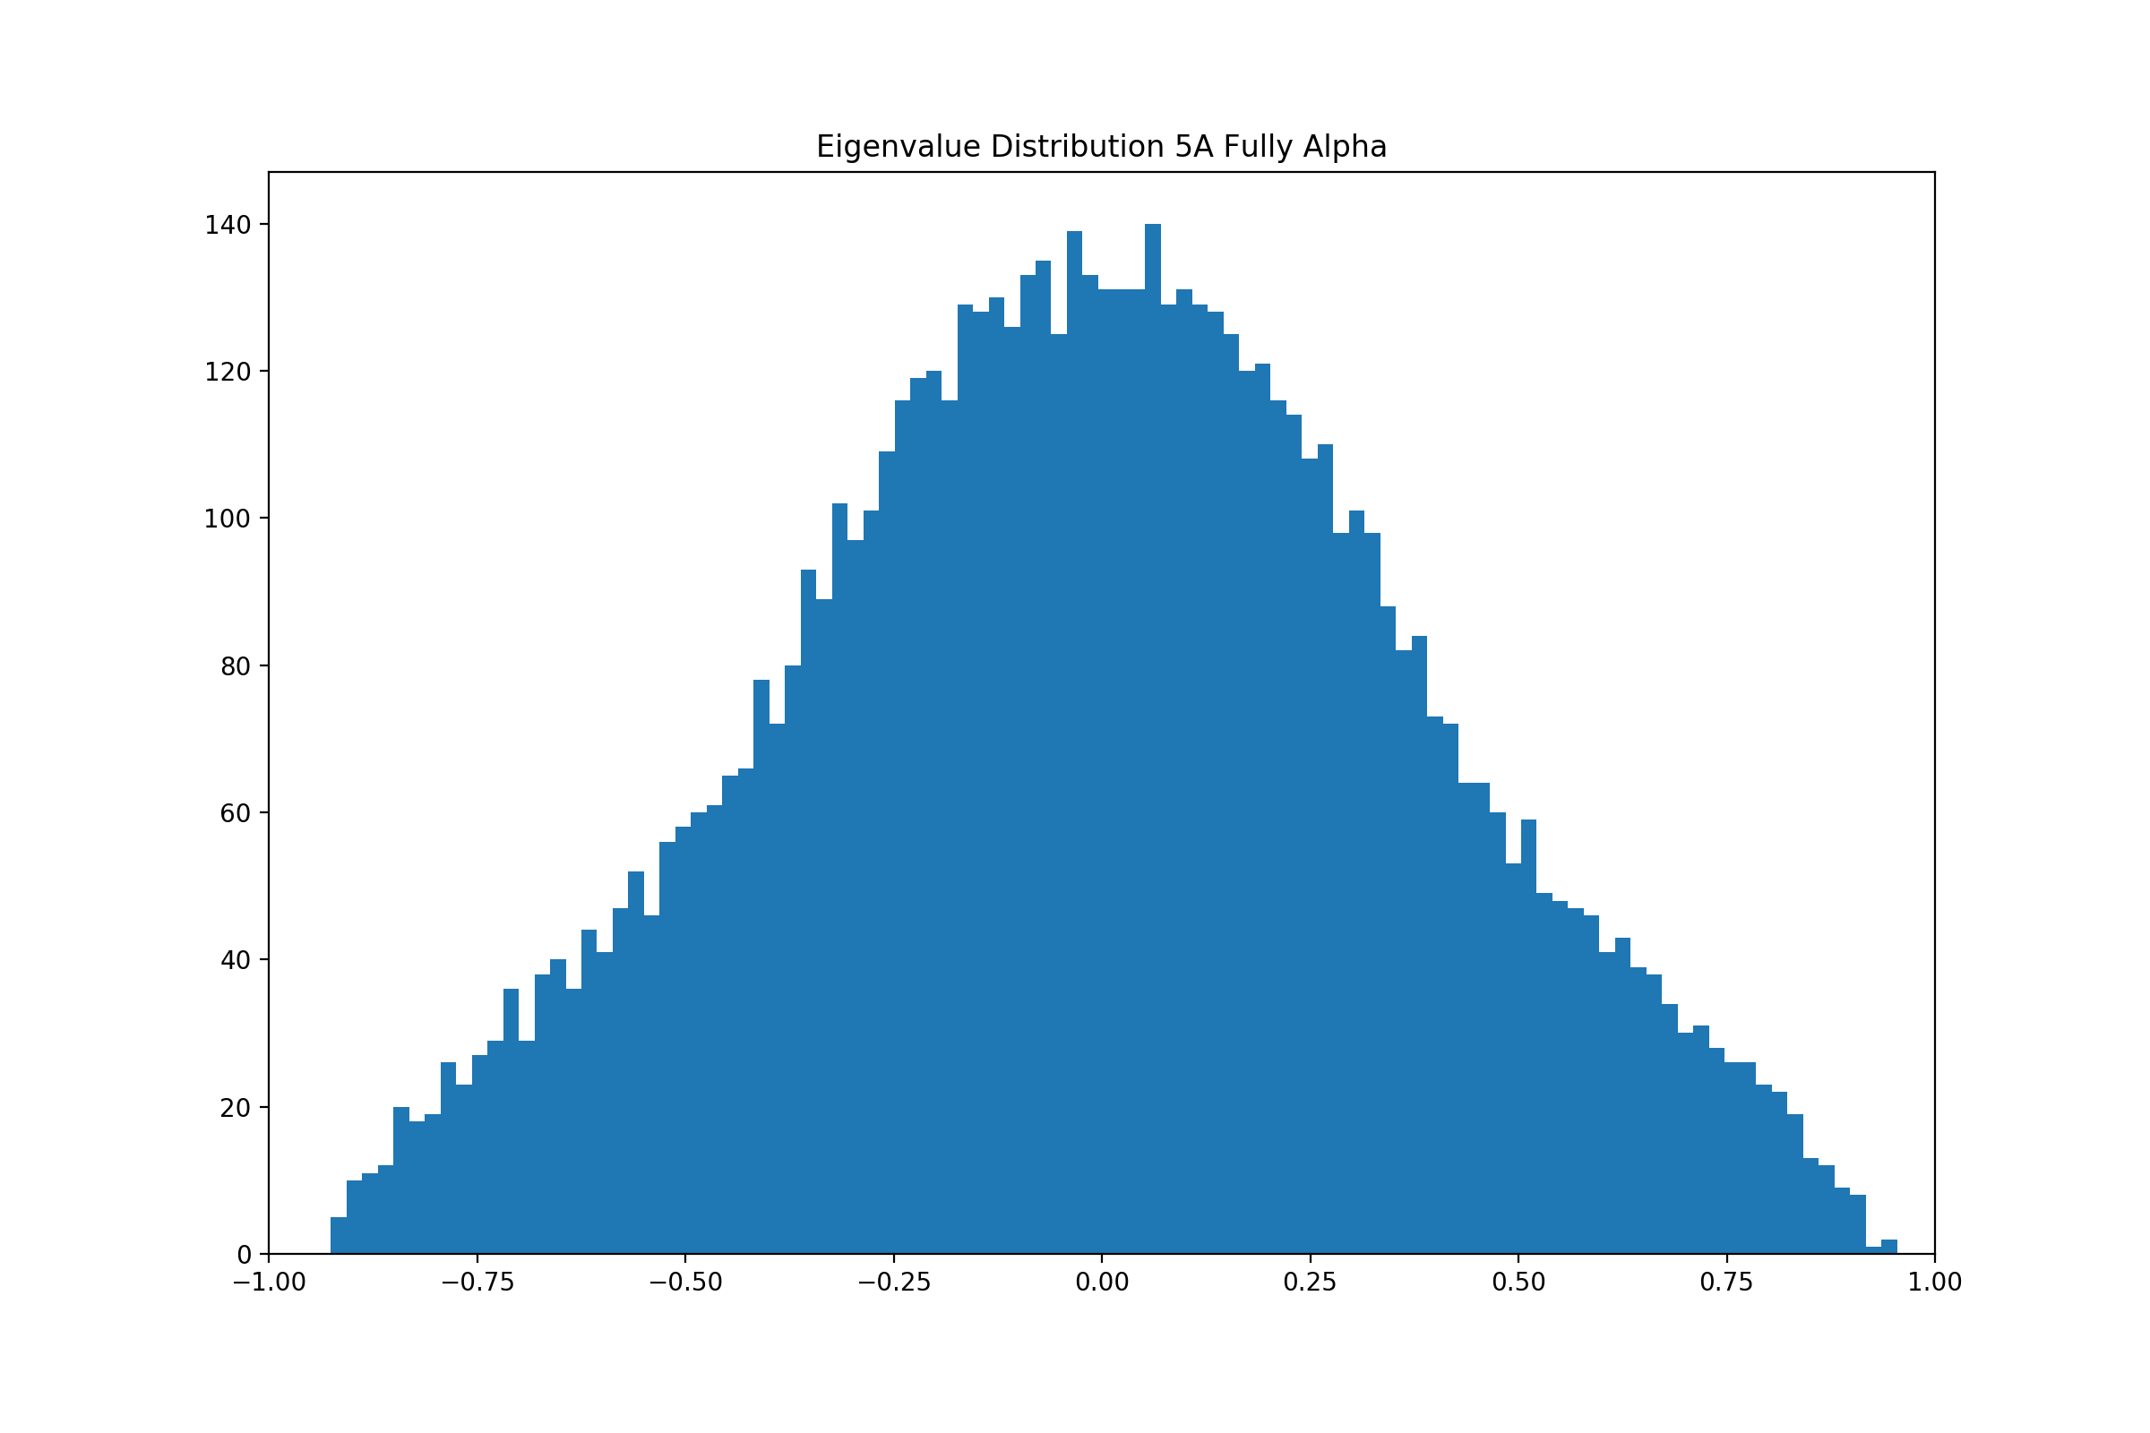
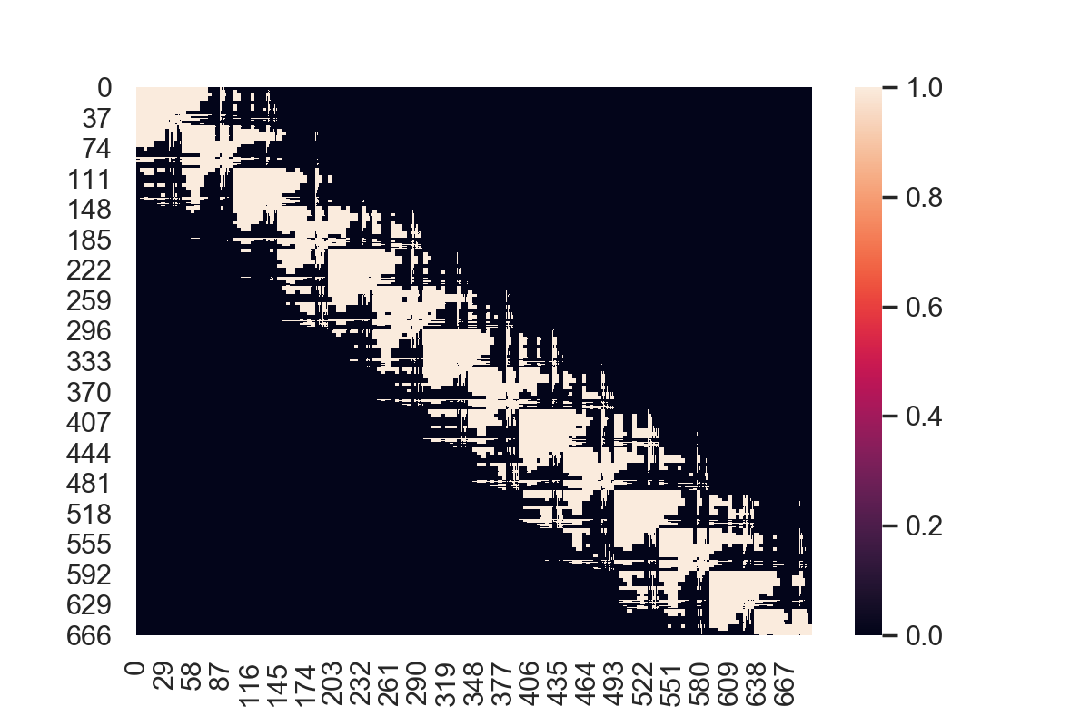
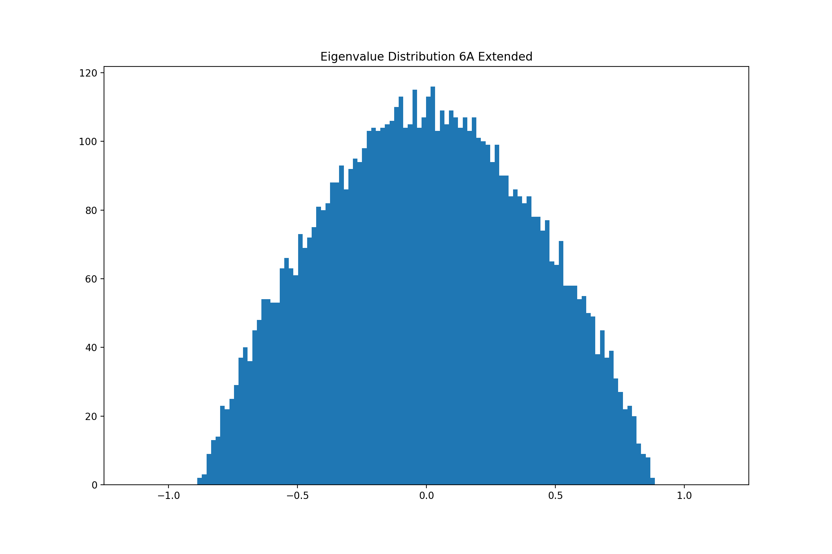
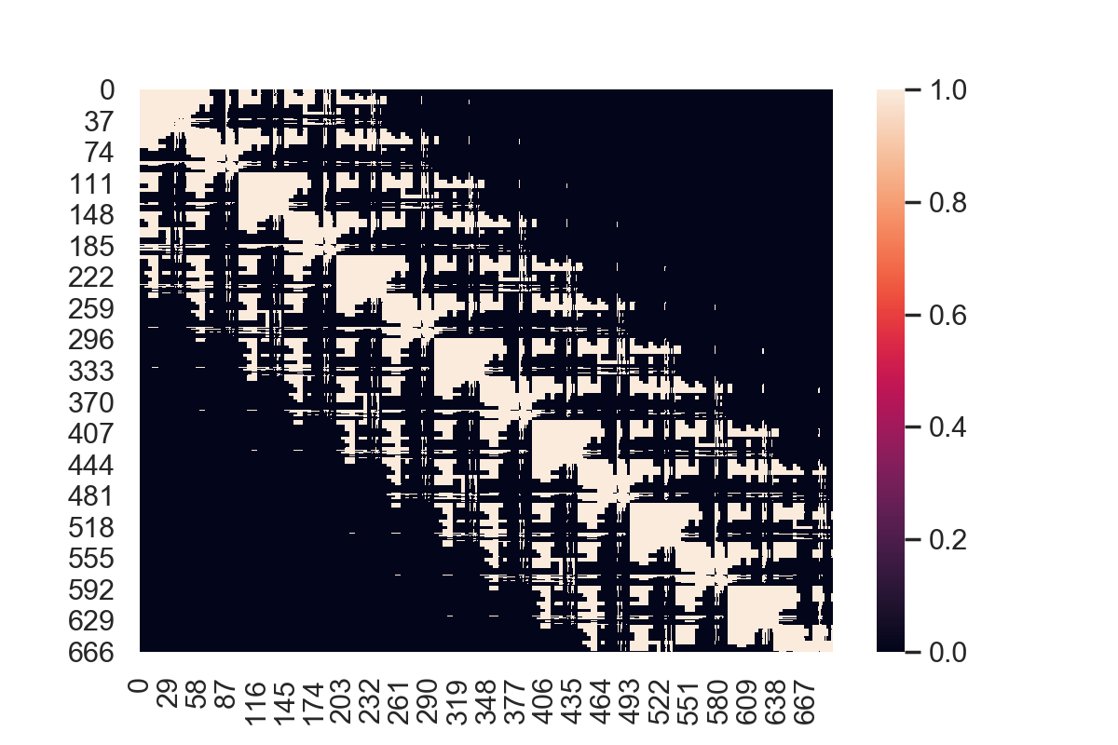
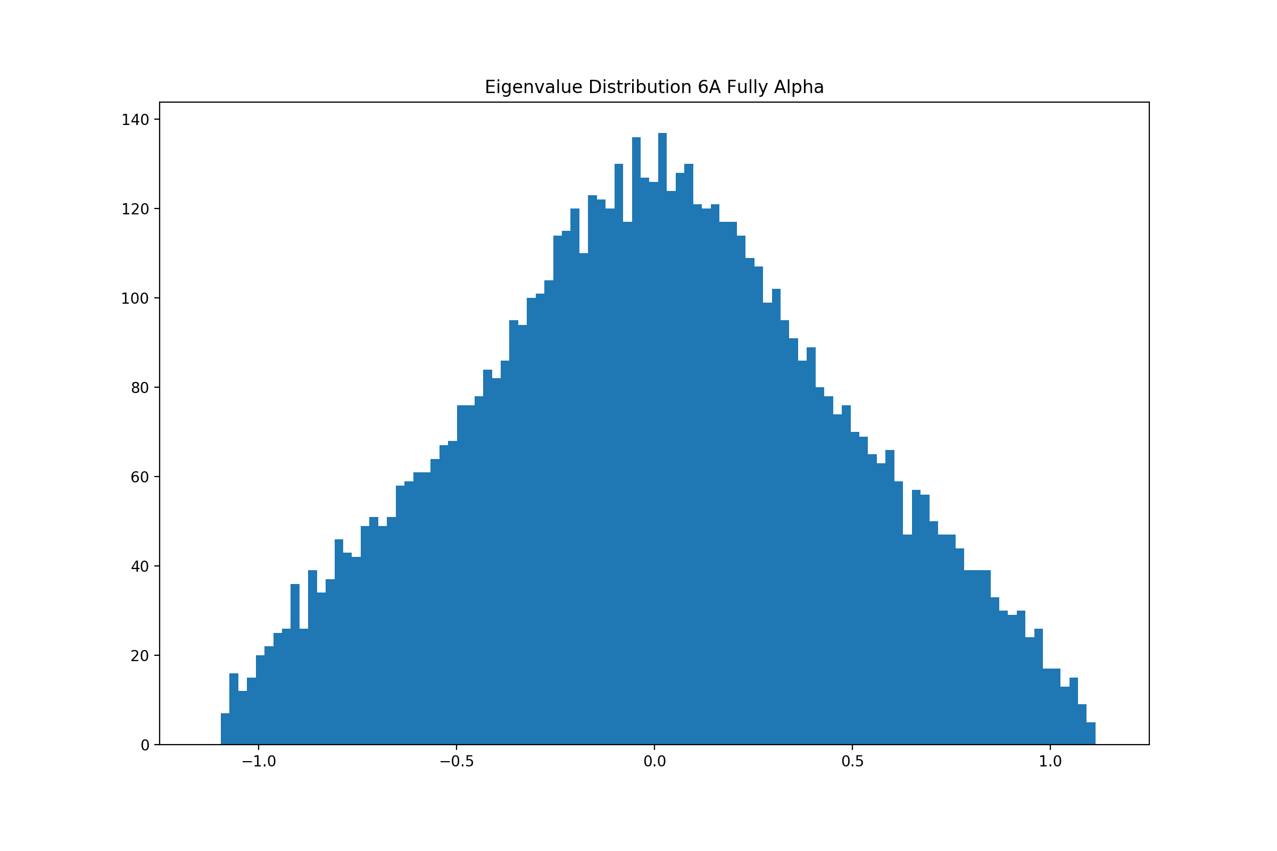
Analysis of Data
4Å
5Å
6Å

Slide 8
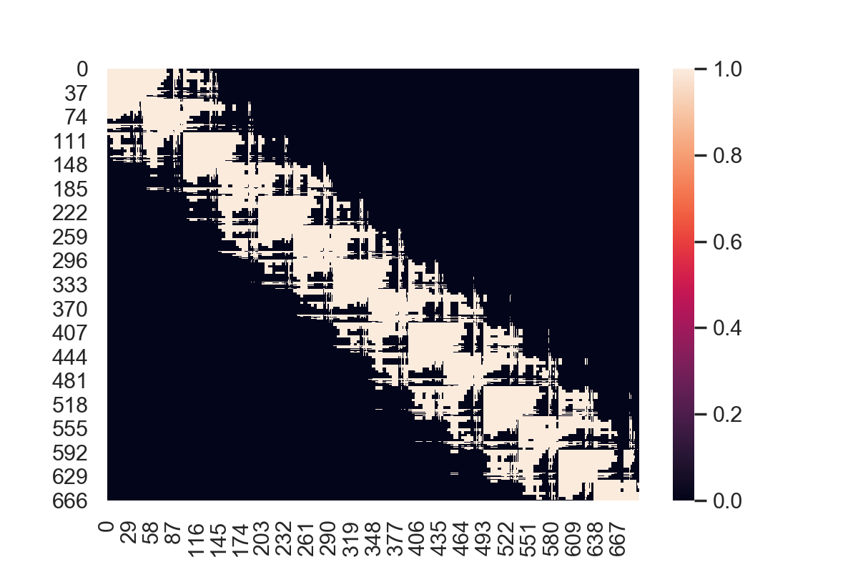
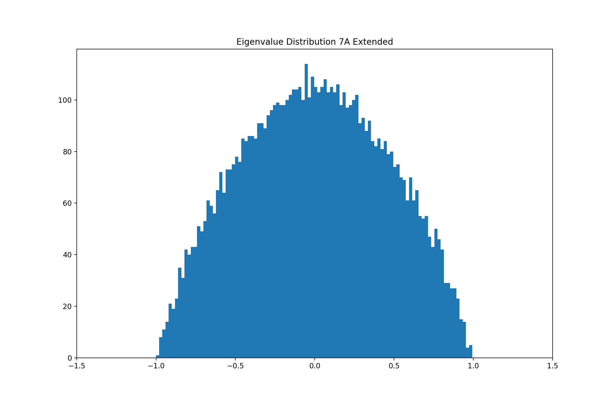
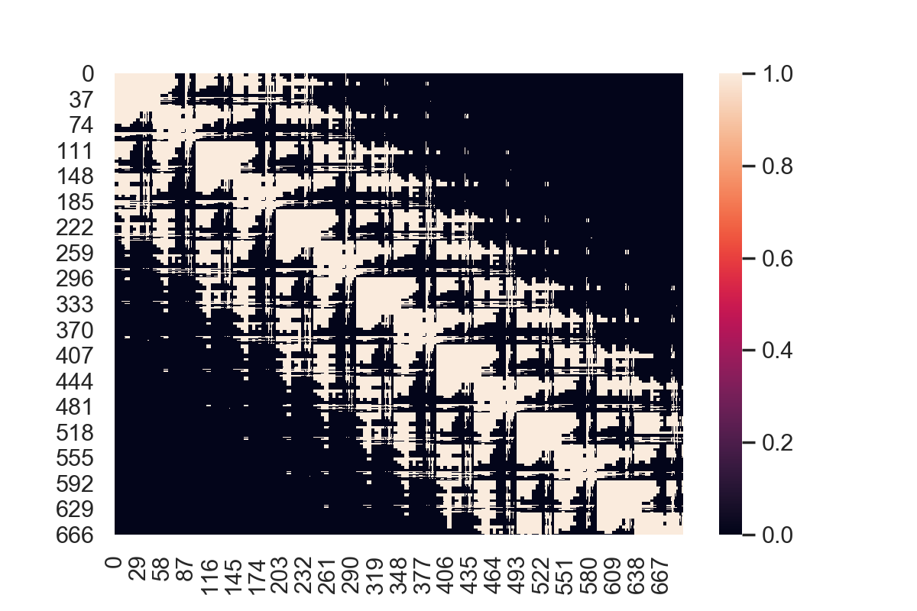
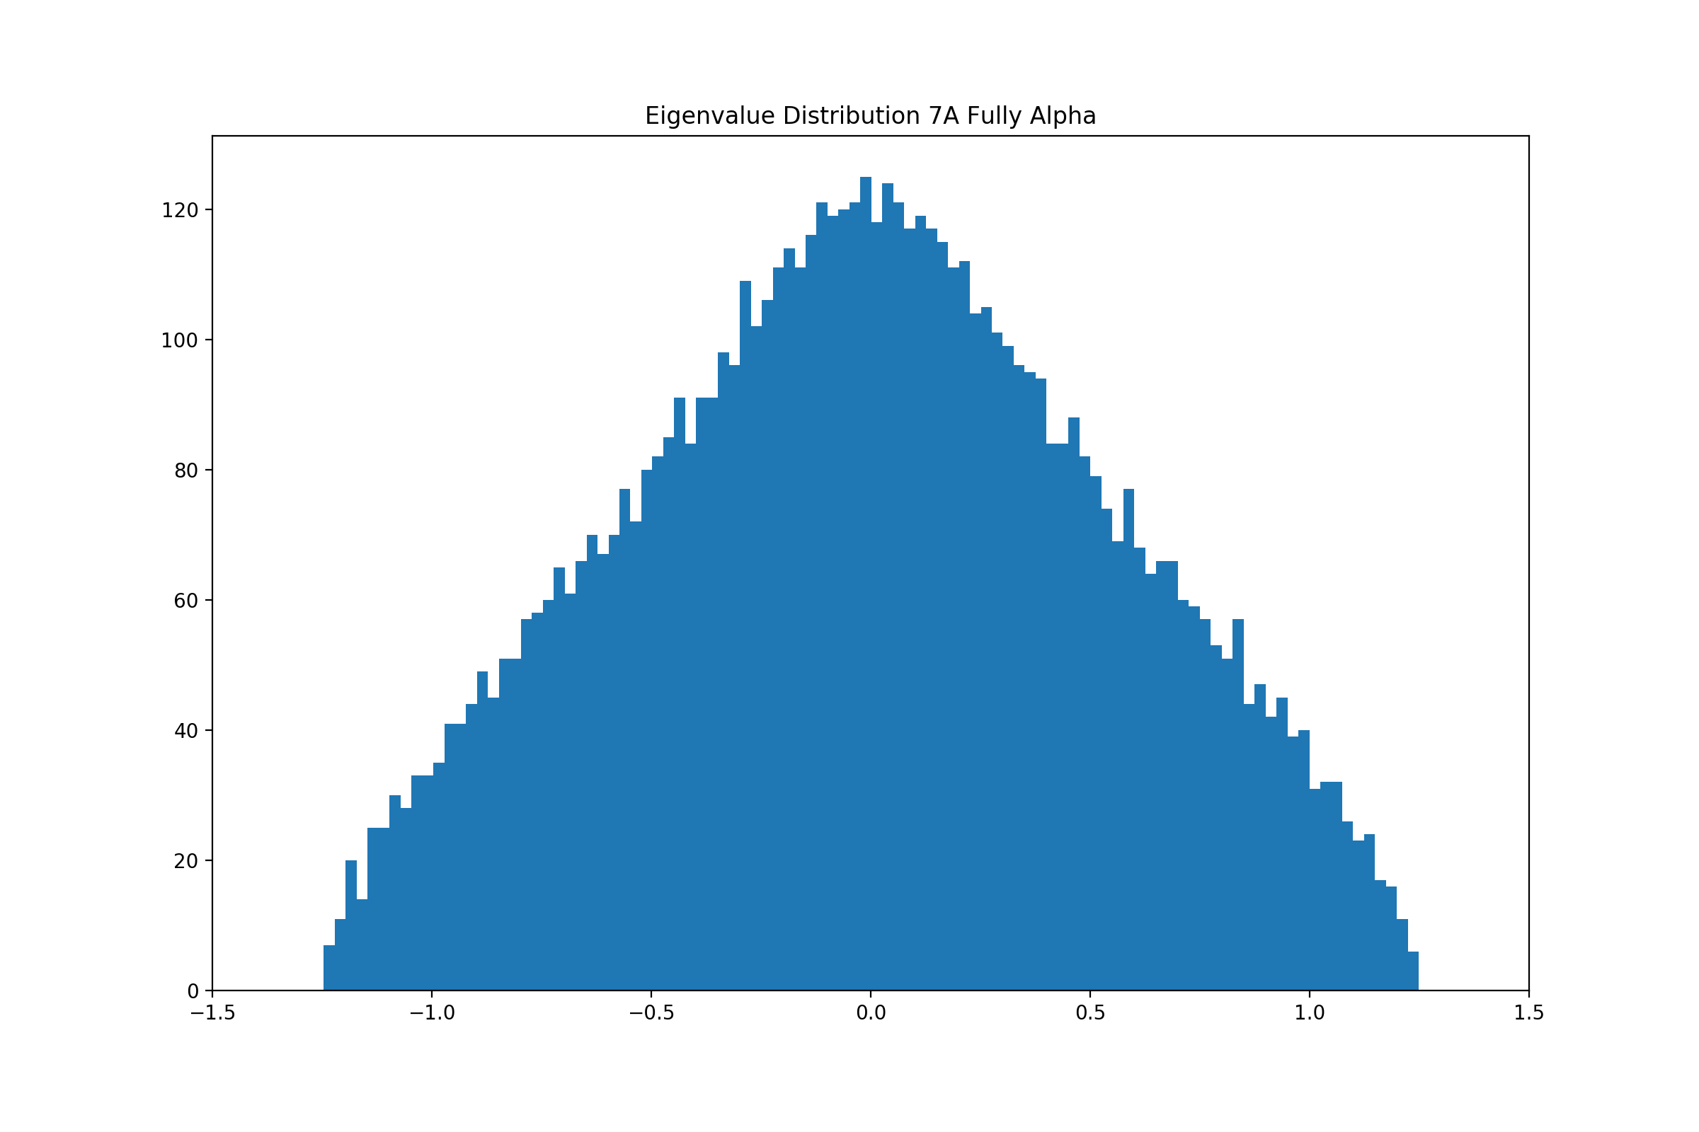
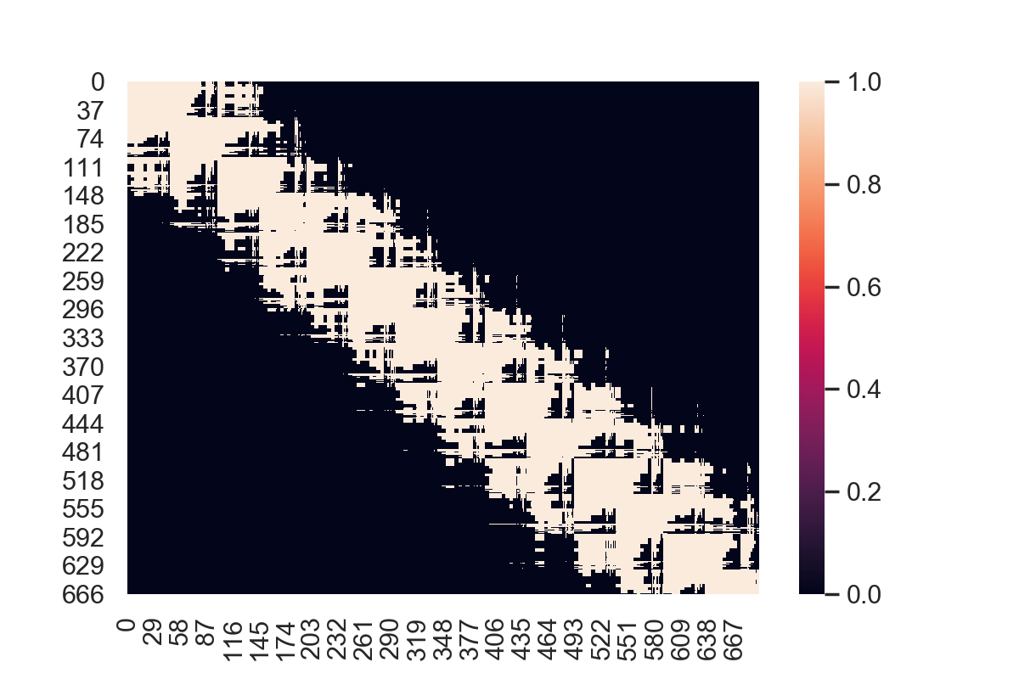
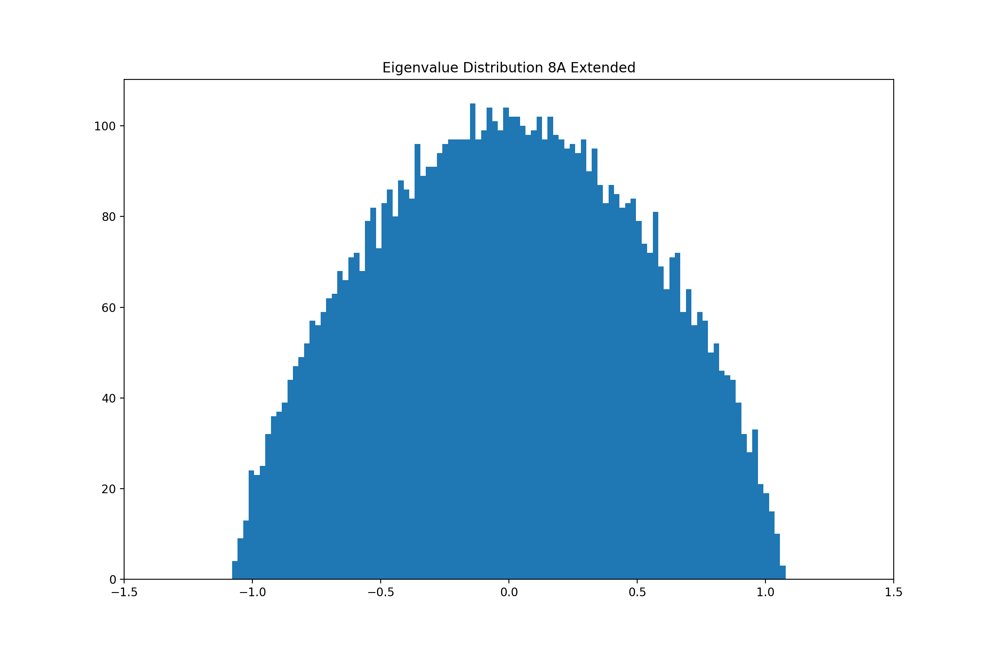
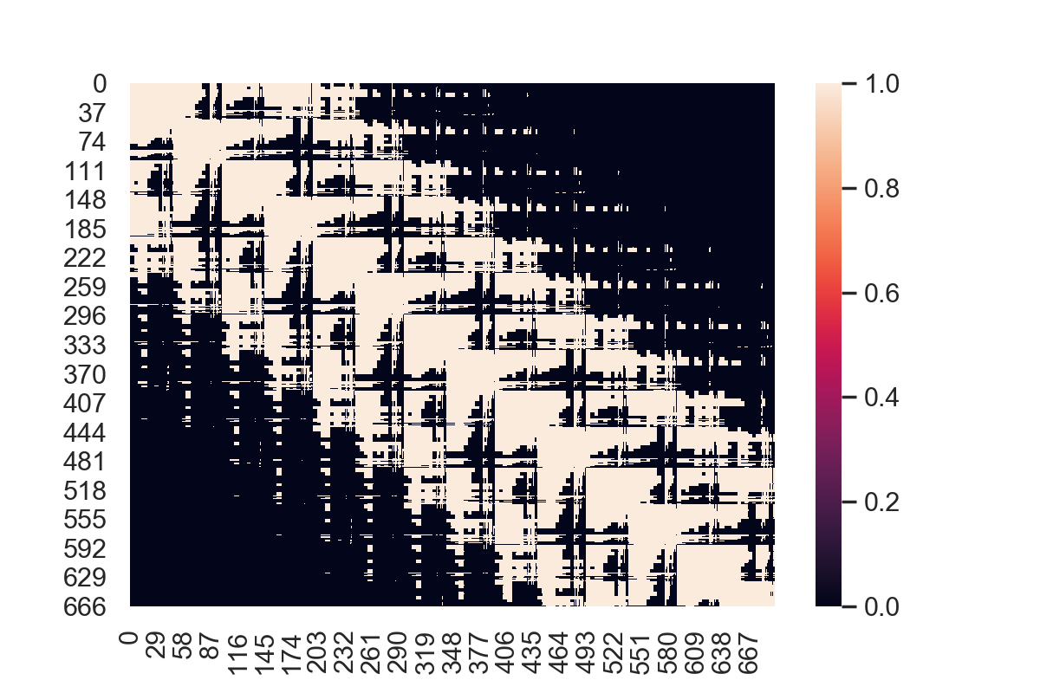
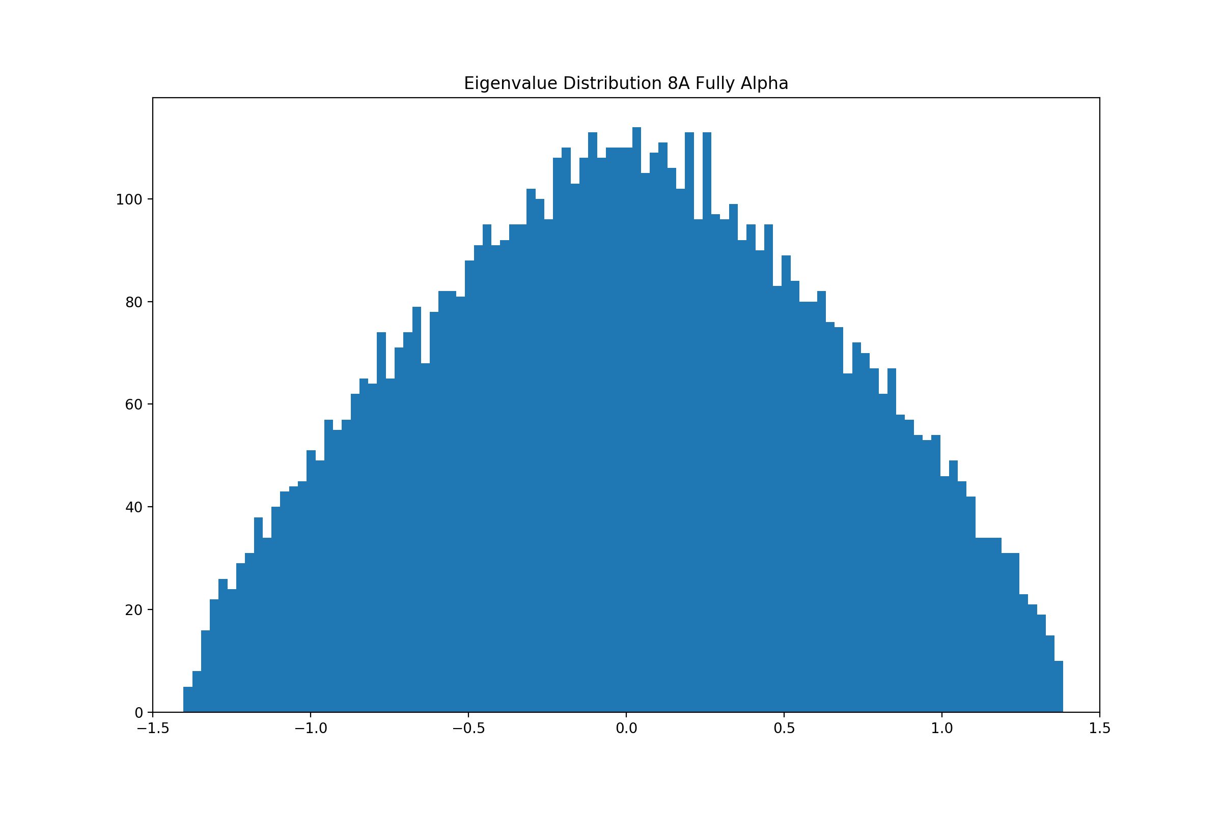
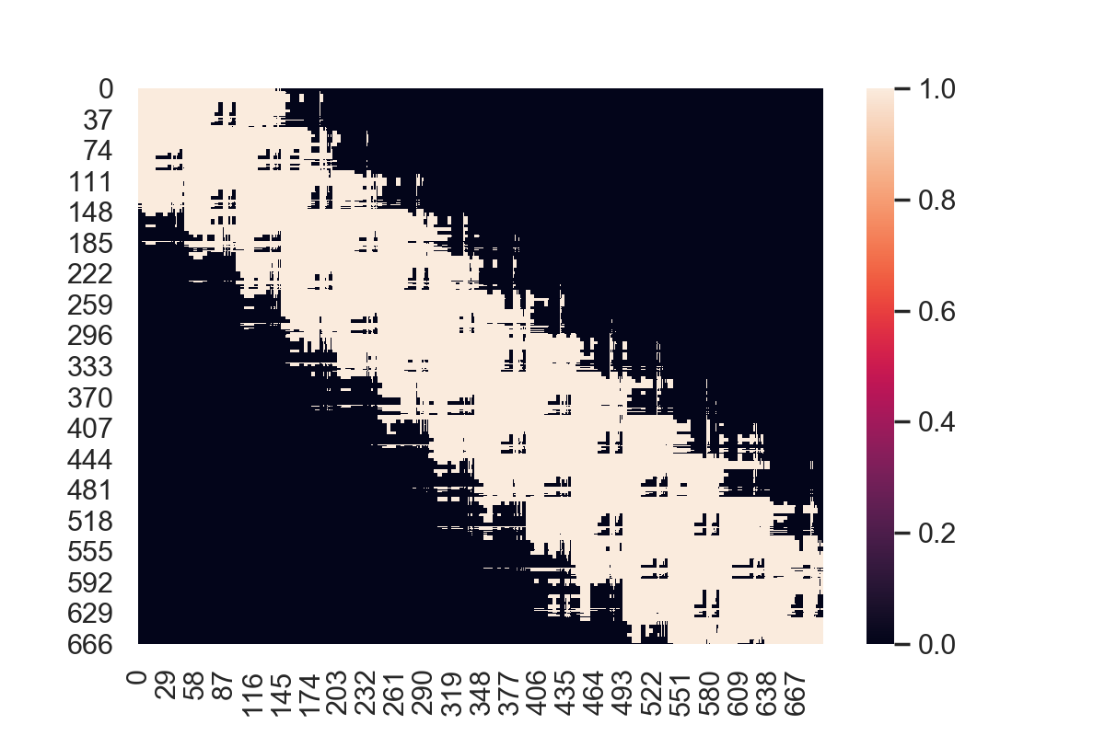
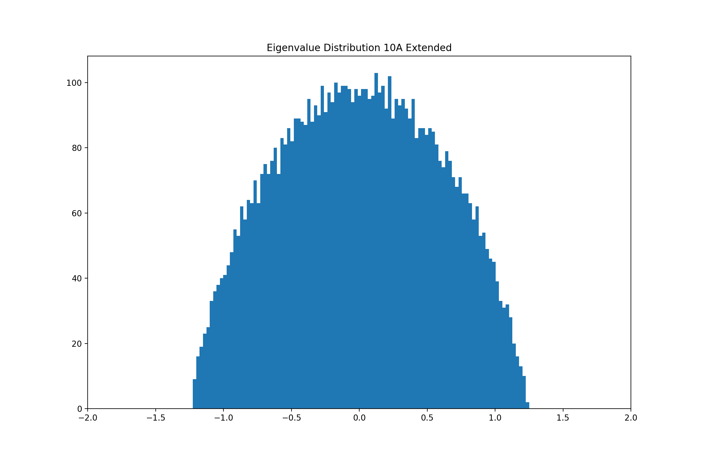
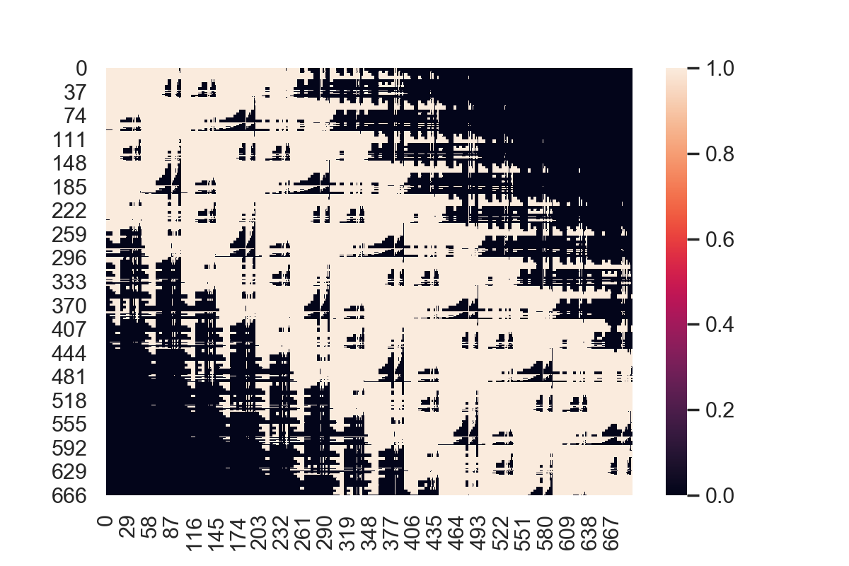
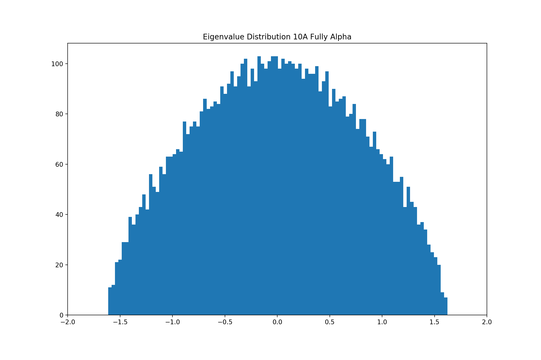
Analysis of Data
7Å
8Å
10Å

Slide 9
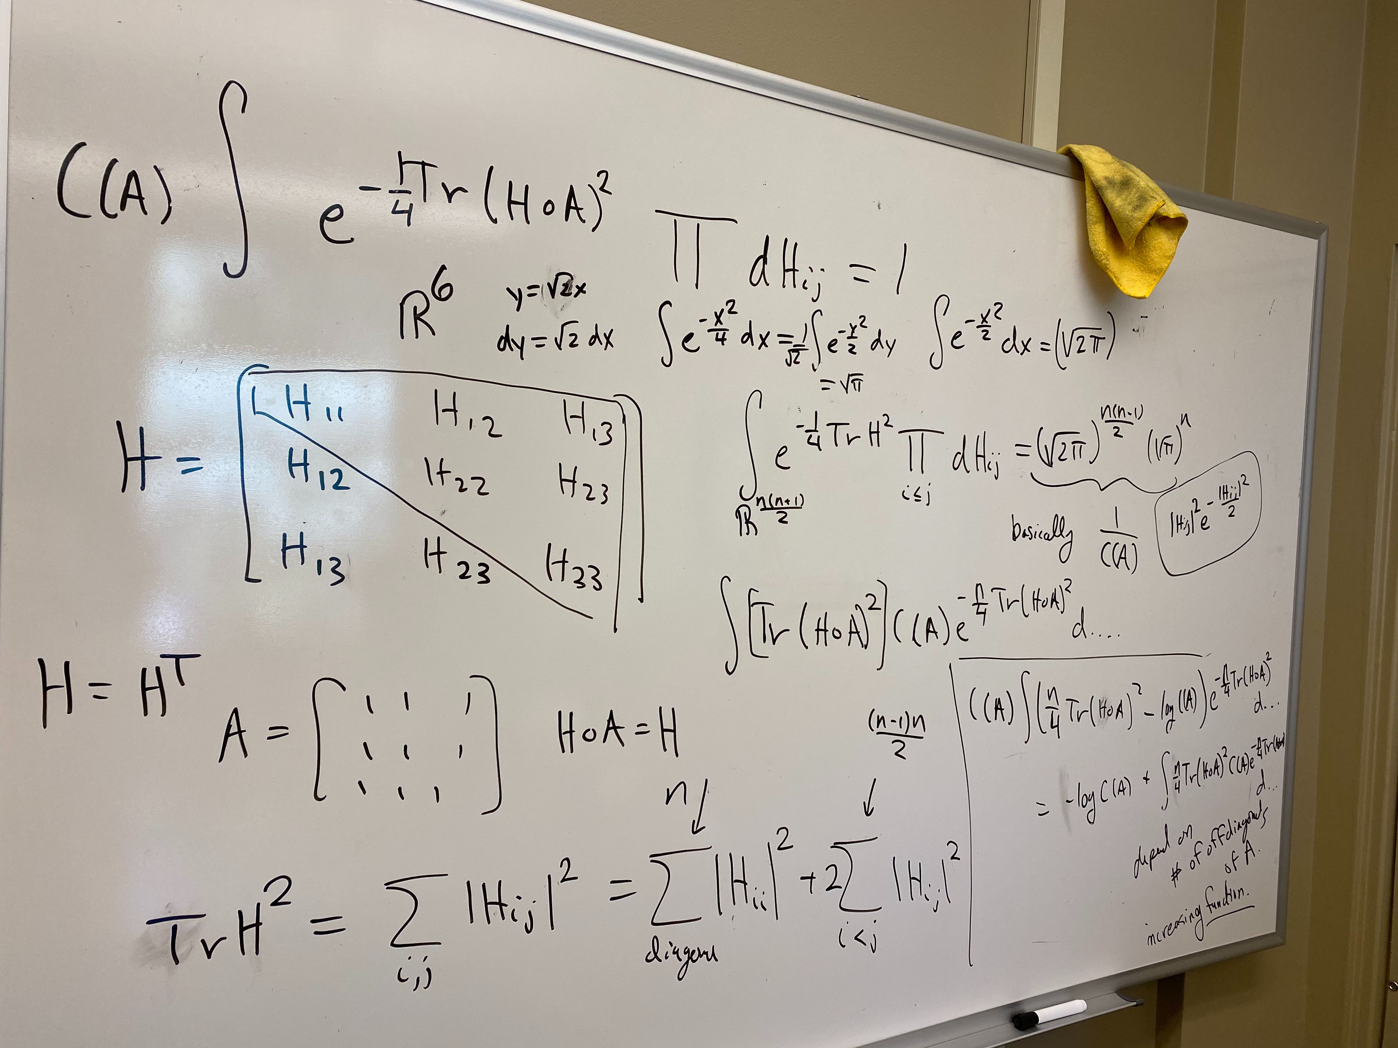

Next steps
Understanding the math behind random graph matrices and calculating continuous entropy and energy
Implement new continuous entropy equation
Include water in adjacency matrices, make algorithm for optimizing water atom validation
Implement individual amino acid electron resonances into code

